Slide 1


Multi-Role

Slide 2
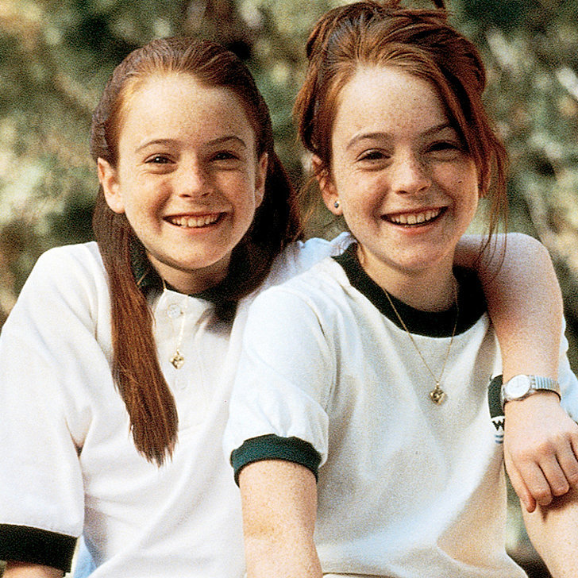
Multi-Role

Slide 3


After watching the two clips, answer the following questions on the twitter card:
Name: @
What do you think the lesson will be about?
I ________________________________________________________________
________________________________________________________________
________________________________________________________________
_______________________________________________________________
________________________________________________________________
2. How do you predict you will do this?
3. What will you need to do this?

Slide 4
I don’t like Mondays

Slide 5
By the end of the lesson…
Learning Objectives
Create a short performance showing a police interrogation
Level 4 : Work successfully in your pair, thinking about your Drama skills
Level 5: Stimulate ideas in the pair, showing how you could use your Drama skills
Level 6 : Work sensitively with others, evaluating as you rehearse to improve the performance
Perform your police interrogation using multi-role
Level 4: Begin to think about multi-role, occasionally using one Drama skill for the multi role
Level 5 : Show multi-role using at least two Drama skills for the multi-role
Level 6 : Employ multi-role effectively throughout the performance using more than two Drama skills
Reflect on the work produced in the lesson
Level 4 – Give a positive comment or a constructive criticism on a performance (using stars wishes).
Level 5 – Explain your comments, justifying your decisions
Level 6 – Evaluate a performance, giving ways in which they could improve their
performance.

Slide 6
Starter
Powerful characters stand on one side of the room facing the other
Scared characters stand on the other side facing back
I will count down from 5. I want you to create a still image of the character you have been given.
What skills are you using to carry out this activity?

Slide 7
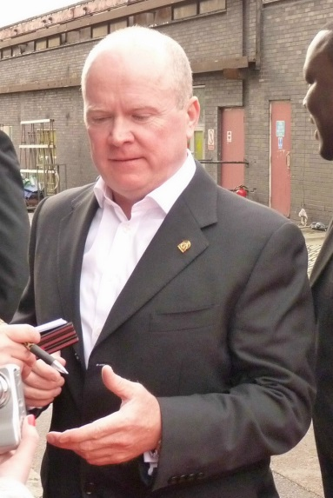
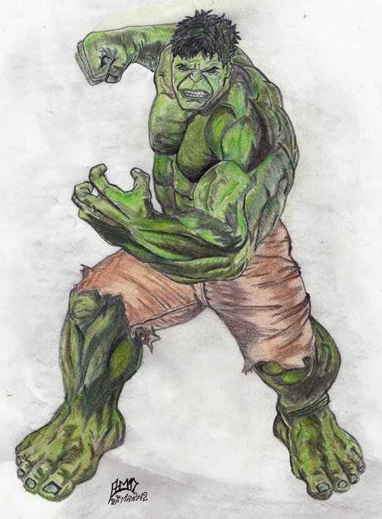
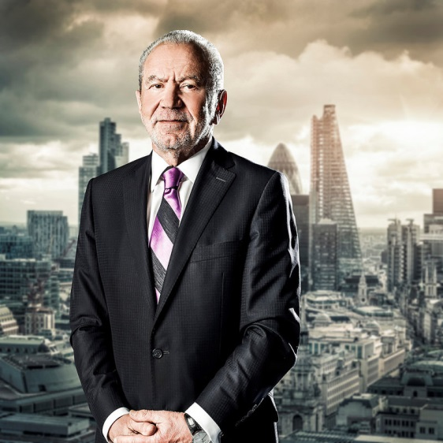
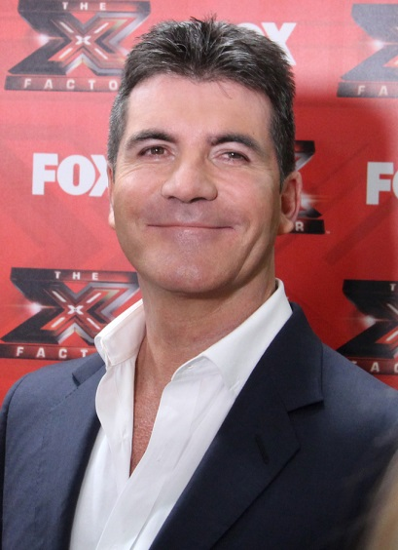
Powerful

Slide 8
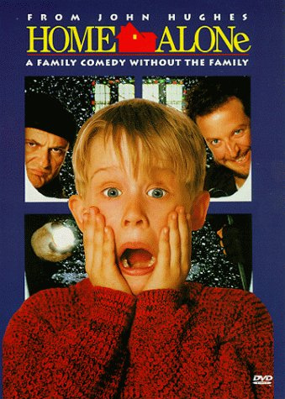
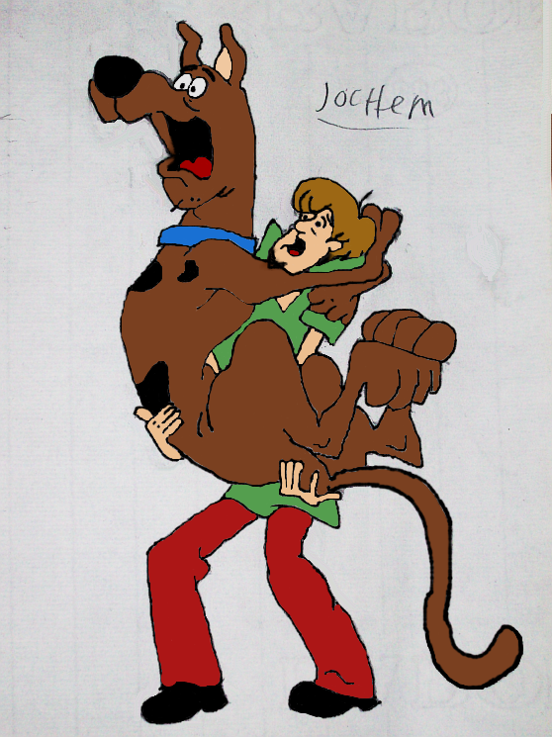
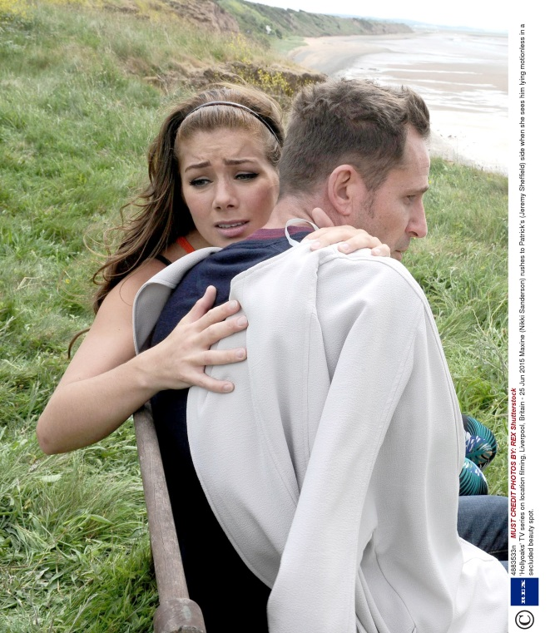
Scared

Slide 9
Say what you see…
Look to the person opposite to you.
How are they different to you?
How are they showing a different character?
What skills are you using to carry out this activity?
What other skills could you use to show more character?
Johnny Depp
Think about this when it comes to your task later.

Slide 10
What do you know?
Multi-role
Multi-role
How can we solve what this word means?
Using your knowledge of acting/the stage, what do you think is the purpose of multi-role?
How can we use it effectively ON STAGE?
Drama skills, so what are these?

Slide 11
I don’t like Mondays
Explanation of Main Task – Police interrogation of Brenda Ann Spencer
What else do you need to know in order to do this?
Information of Brenda Ann Spencer
Teacher modelling

Slide 12
Main Task
What problems could you face when completing this?
How will you overcome these problems?
Label A and B
Still image
Improvise
Swap
Stop and share
Run
Perform

Slide 13
Performance

Slide 14
By the end of the lesson…
Learning Objectives
Create a short performance showing a police interrogation
Level 4 : Work successfully in your pair, thinking about your Drama skills
Level 5: Stimulate ideas in the pair, showing how you could use your Drama skills
Level 6 : Work sensitively with others, evaluating as you rehearse to improve the performance
Perform your police interrogation using multi-role
Level 4: begin to think about multi-role, occasionally using one Drama skill for the multi role
Level 5 : show multi-role using at least two Drama skills for the multi-role
Level 6 : employ multi-role effectively throughout the performance using more than two Drama skills
Comment on the work produced in the lesson
Level 4 – Give a positive comment or a constructive criticism on a performance (using two stars and a wish).
Level 5 – Explain your comments, justifying your decisions
Level 6 – Evaluate a performance, giving ways in which they could improve their
performance.

Slide 15
Drama Skills
In order to make our multi-role successful, we need to use/change the following:
Facial expressions
Body language
Gestures
Levels
Voice

Slide 16
Ticket out
After watching the performance, answer:
What skills did you use to complete this task?
If you could participate in this task again – what would you do differently next time?
How could any errors that were made be overcome?

Slide 17
Acknowledgements
Steve McFadden, Flickr Creative Commons
The Incredible Hulk by Ghostgd. Deviantart.com Creative Commons
Gage. Simon Cowell, Wikimedia Creative Commons
Taylor Herring. Lord Sugar, Flickr Creative Commons
Shaggy and Scooby Doo by NeoseekerStitch. Deviantart.com Creative Commons.
S_herman. Home Alone, Flickr Creative Commons.
Hollyoaks - Rex Shutterstock

